Slide 1
Bank Database Design ---XUE LIU(Alexia)
3

Slide 2
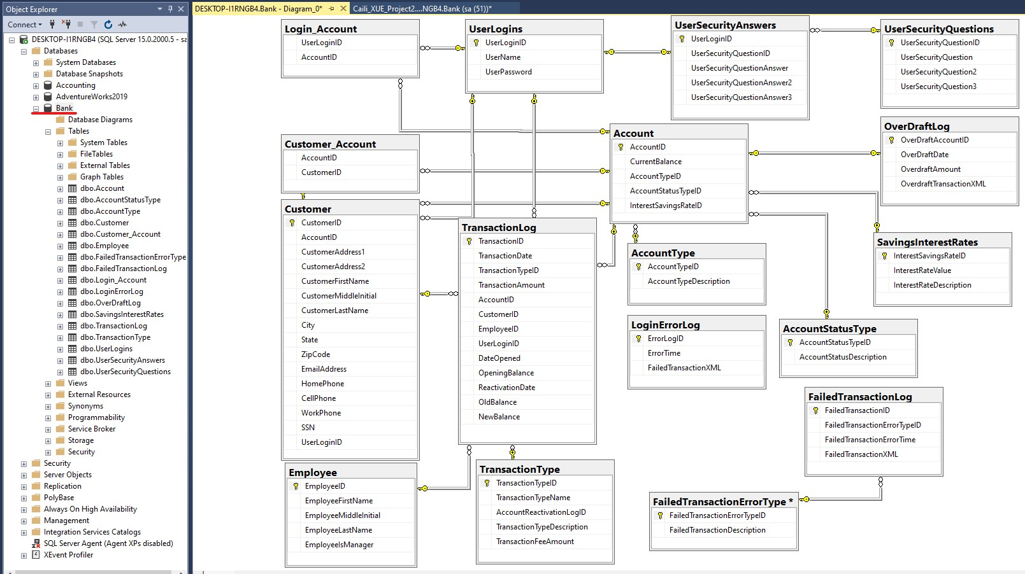
Entity-Relationship Diagram
7

Slide 3
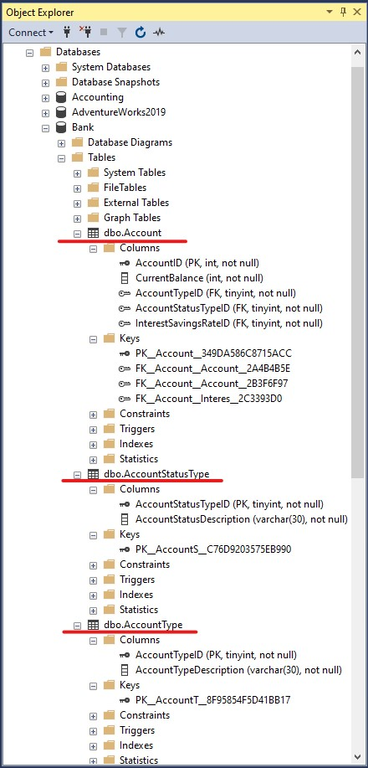
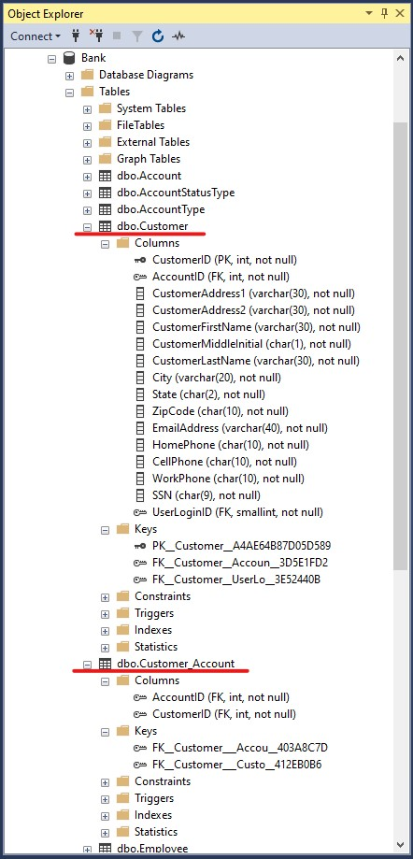
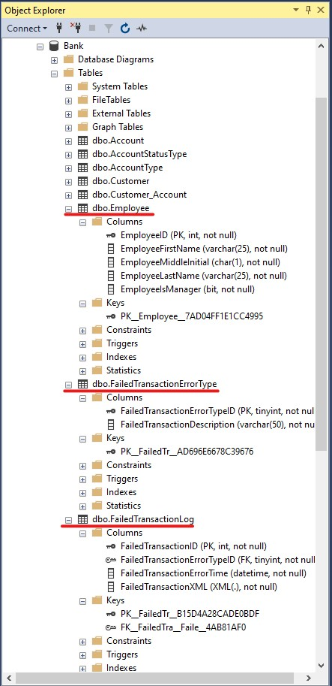
ALL Tables PK & FK_Total 17 Tables
7

Slide 4
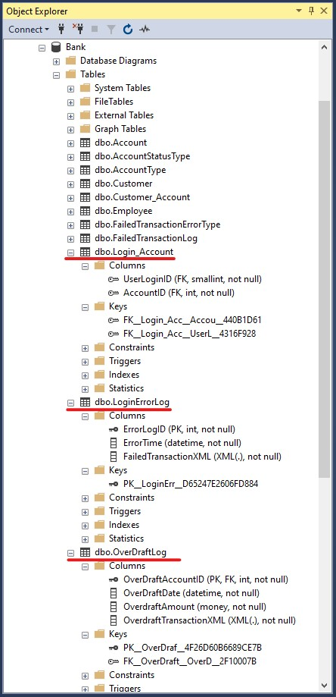
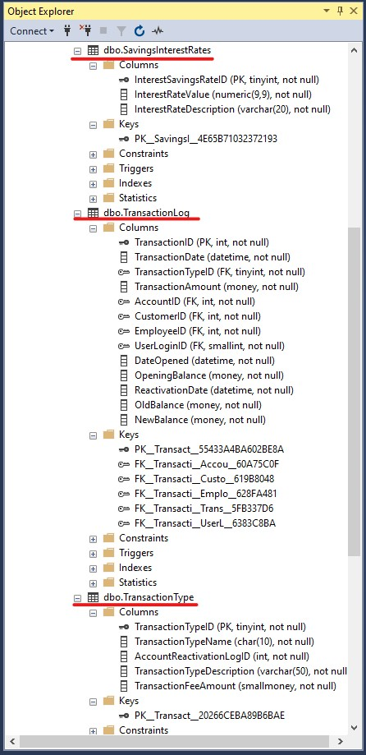
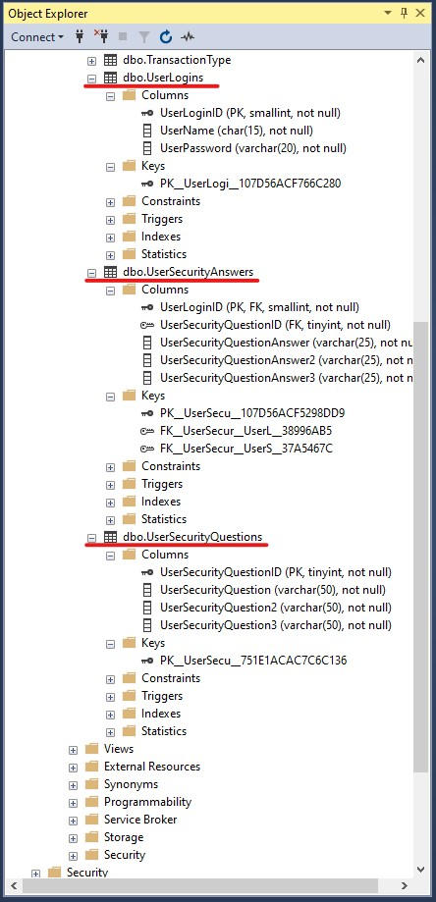
ALL Tables PK & FK_Total 17 Tables
7

Slide 5
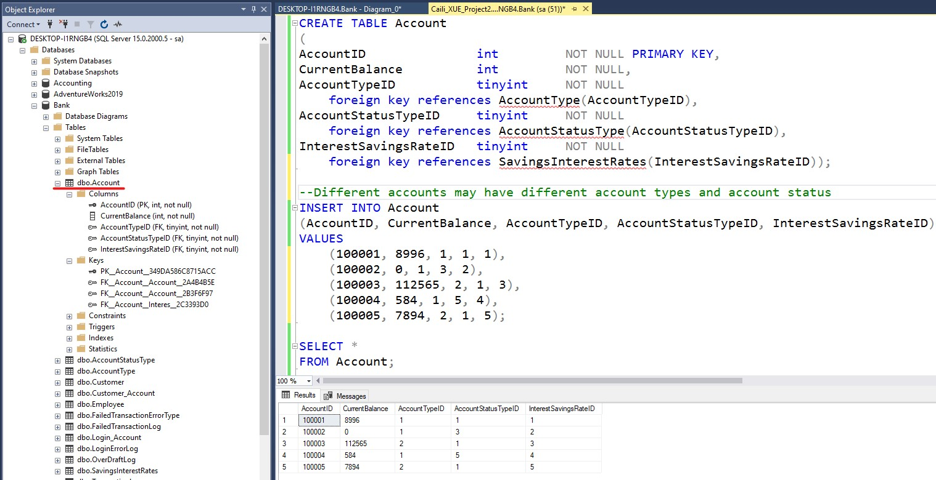
Table_Account
7

Slide 6
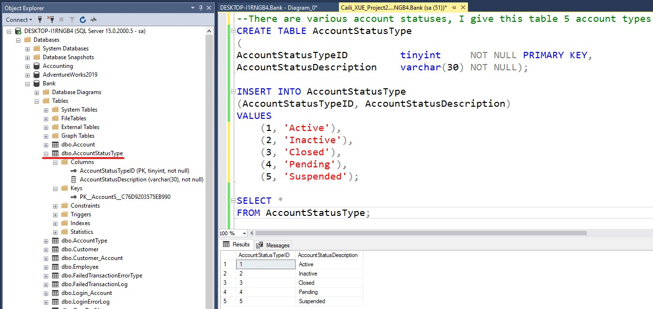
Table_AccountStatusType
7

Slide 7
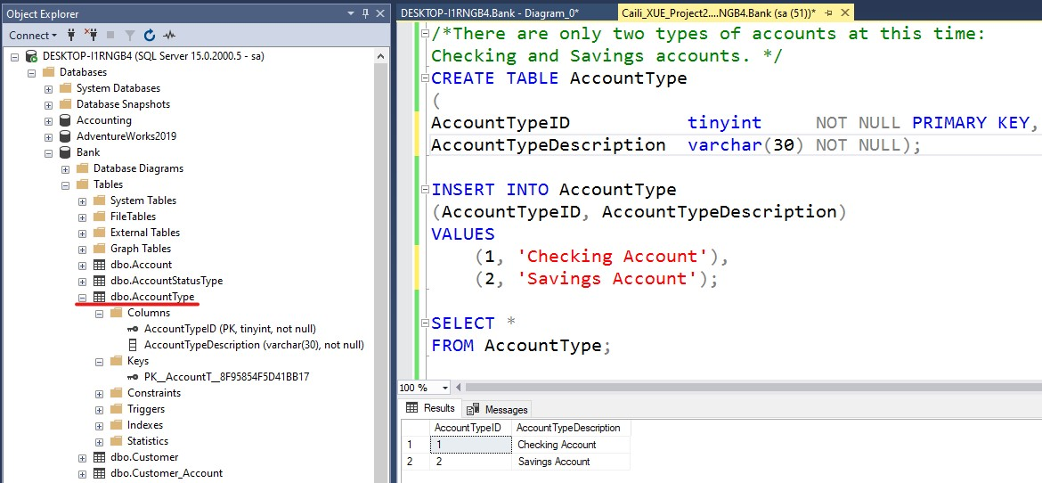
Table_AccountType
7

Slide 8
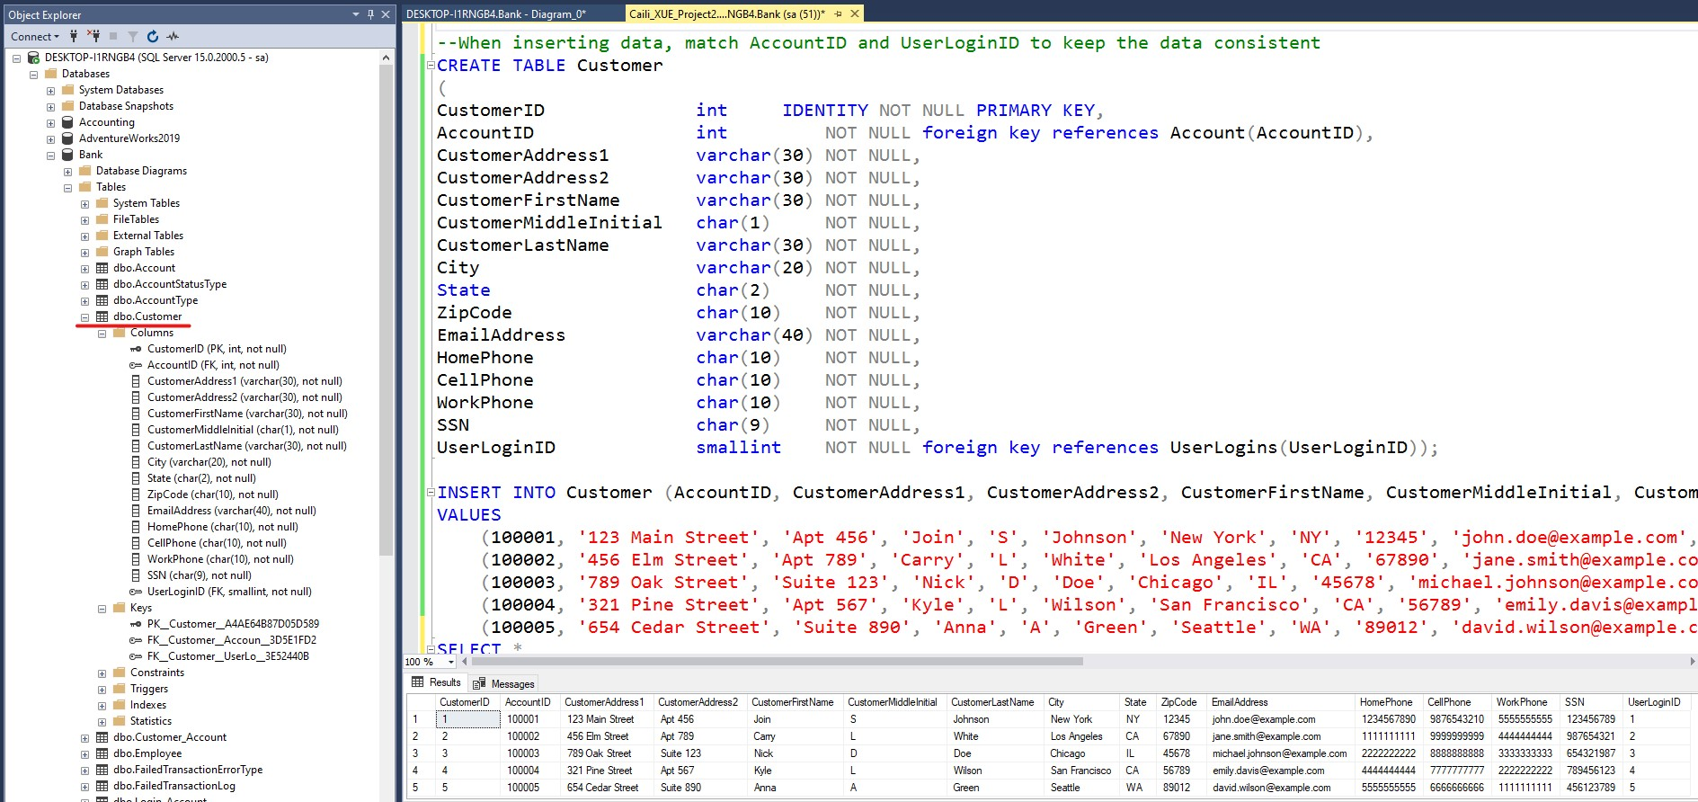
Table_Customer
7

Slide 9
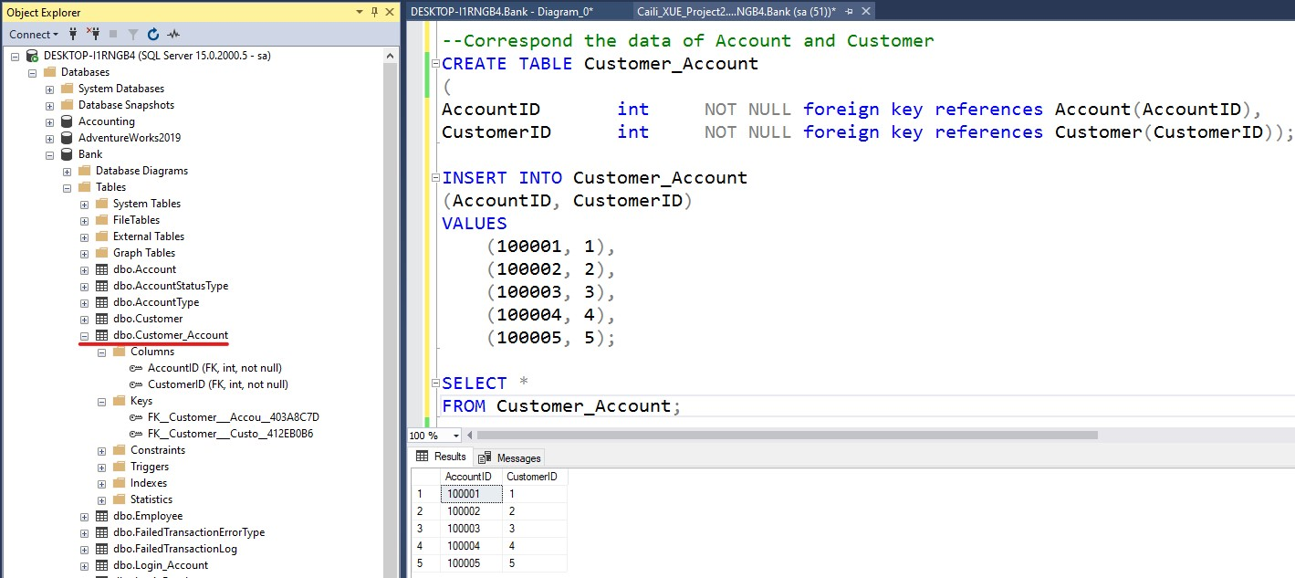
Table_Customer_Account
7

Slide 10
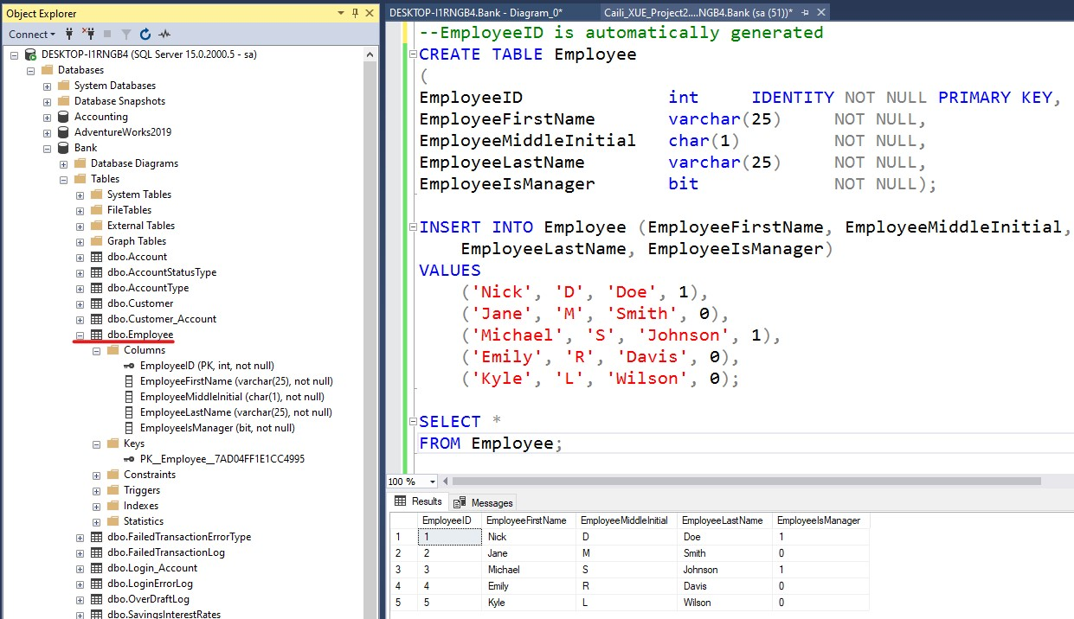
Table_Employee
7

Slide 11
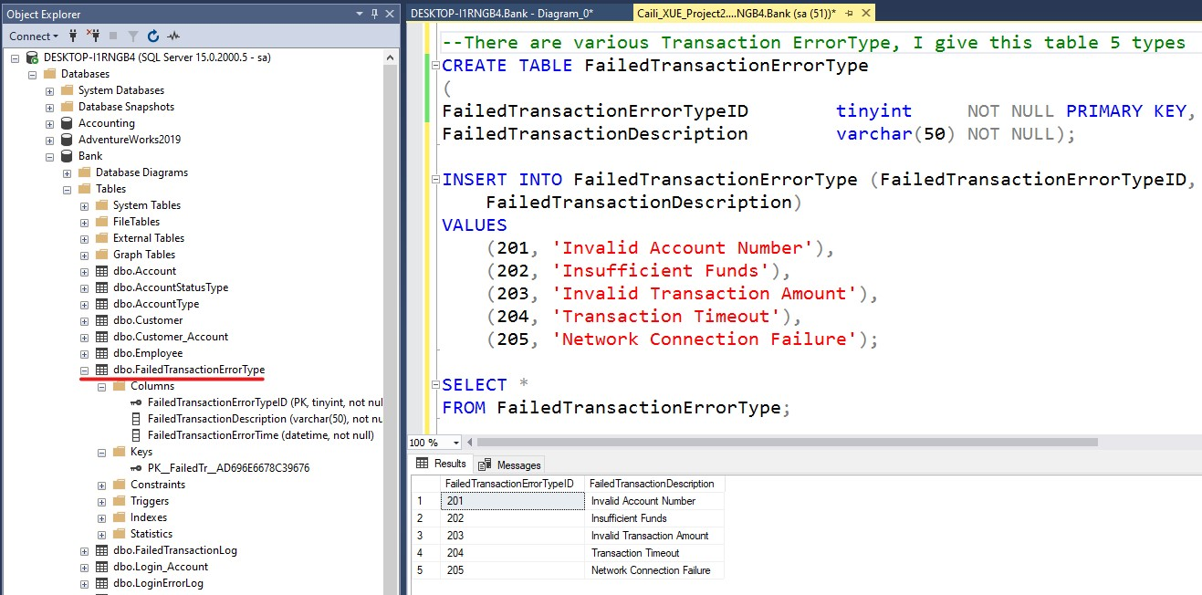
Table_FailedTransactionErrorType
7

Slide 12
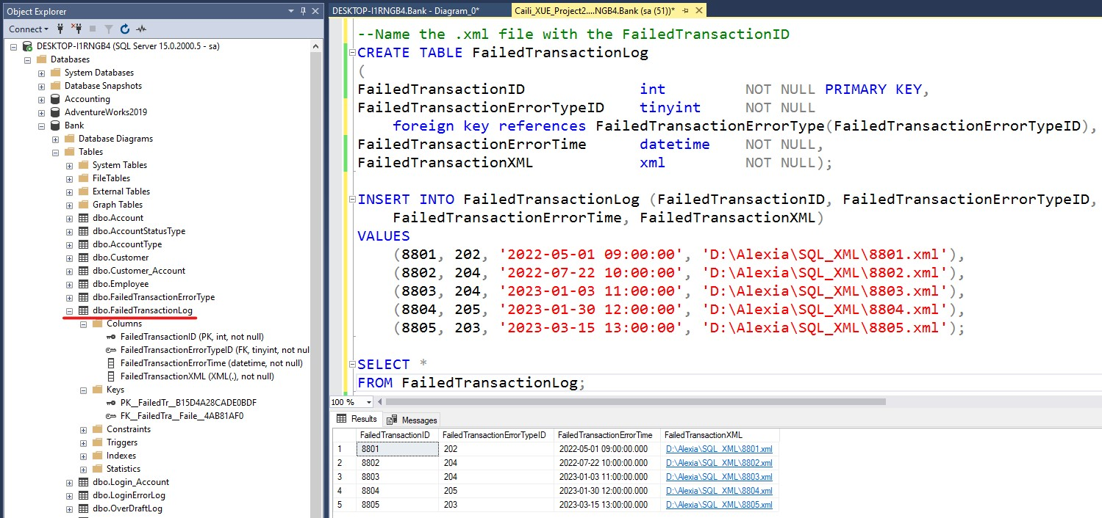
Table_FailedTransactionLog
7

Slide 13
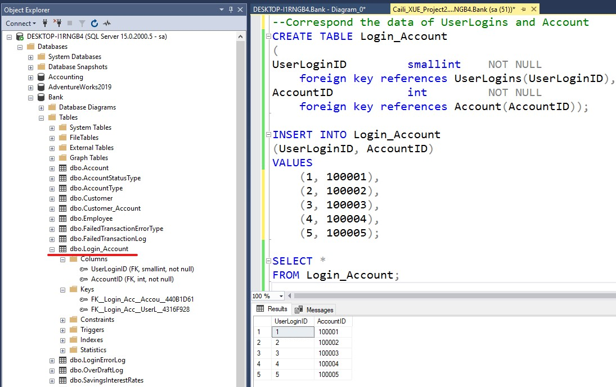
Table_Login_Account
7

Slide 14
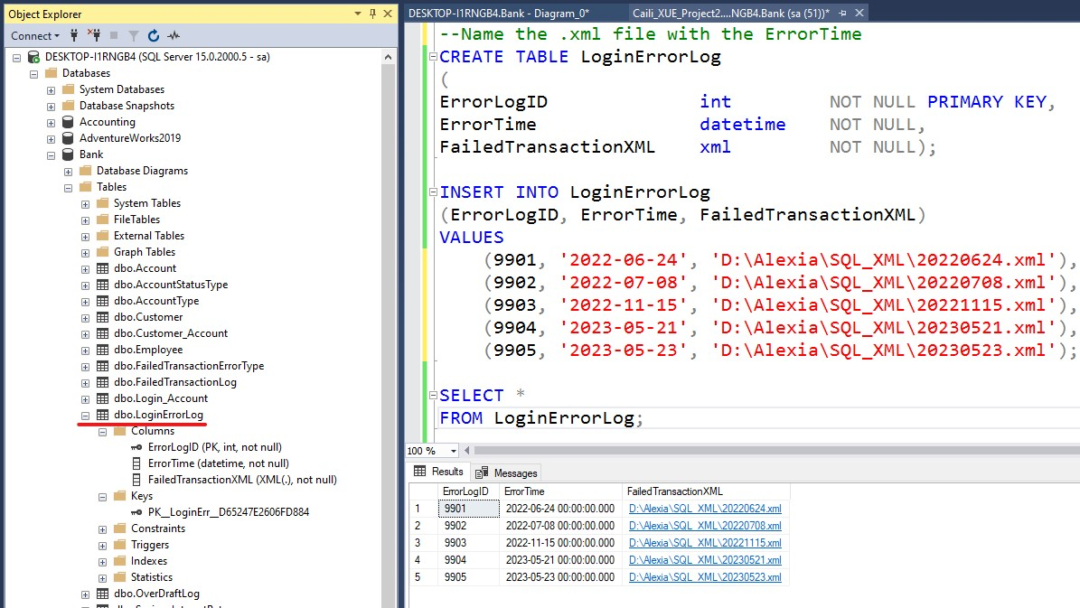
Table_LoginErrorLog
7

Slide 15
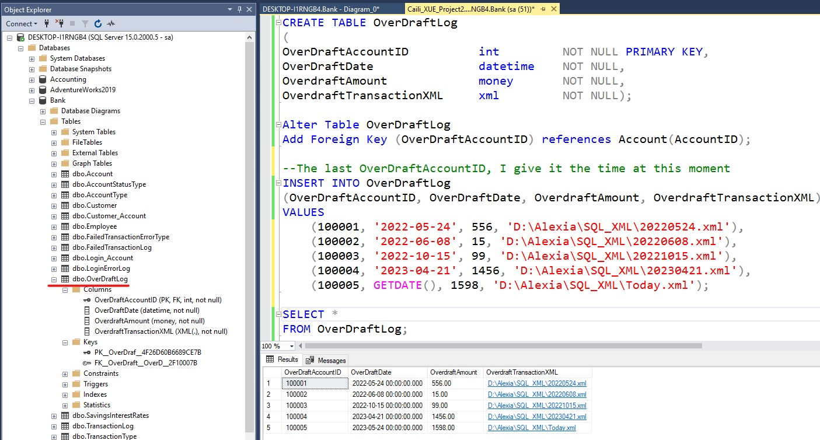
Table_OverDraftLog
7

Slide 16
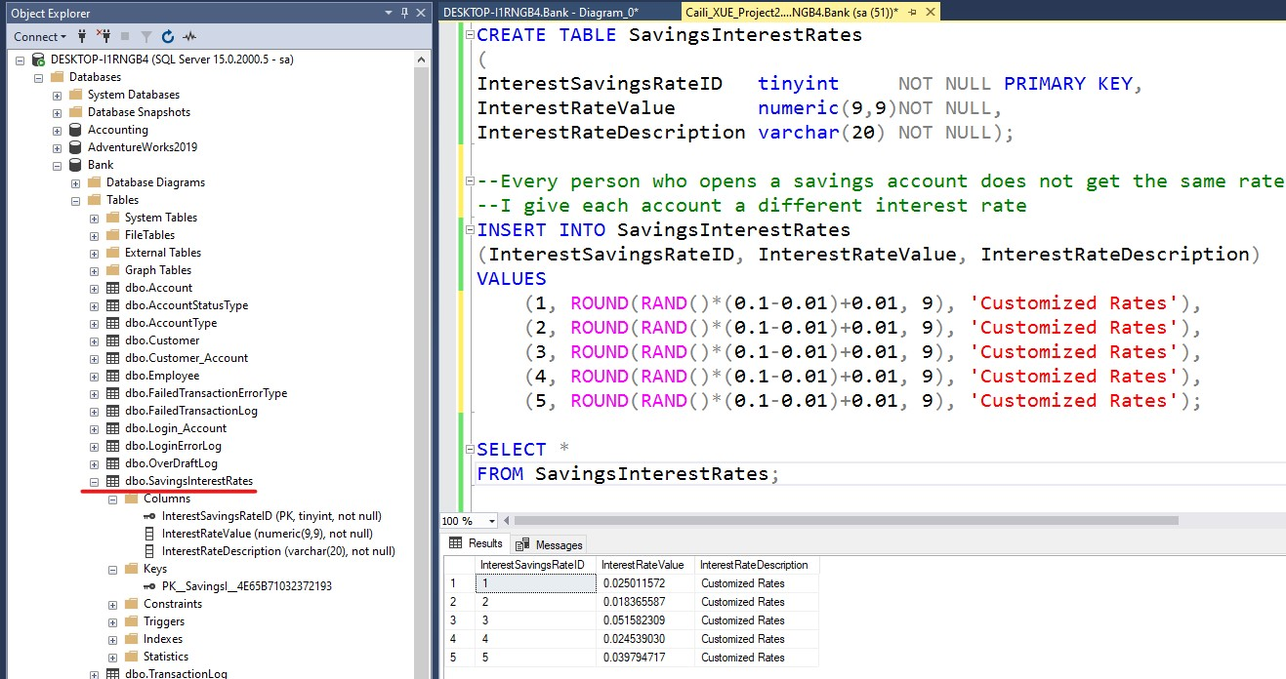
Table_SavingsInterestRates
7

Slide 17
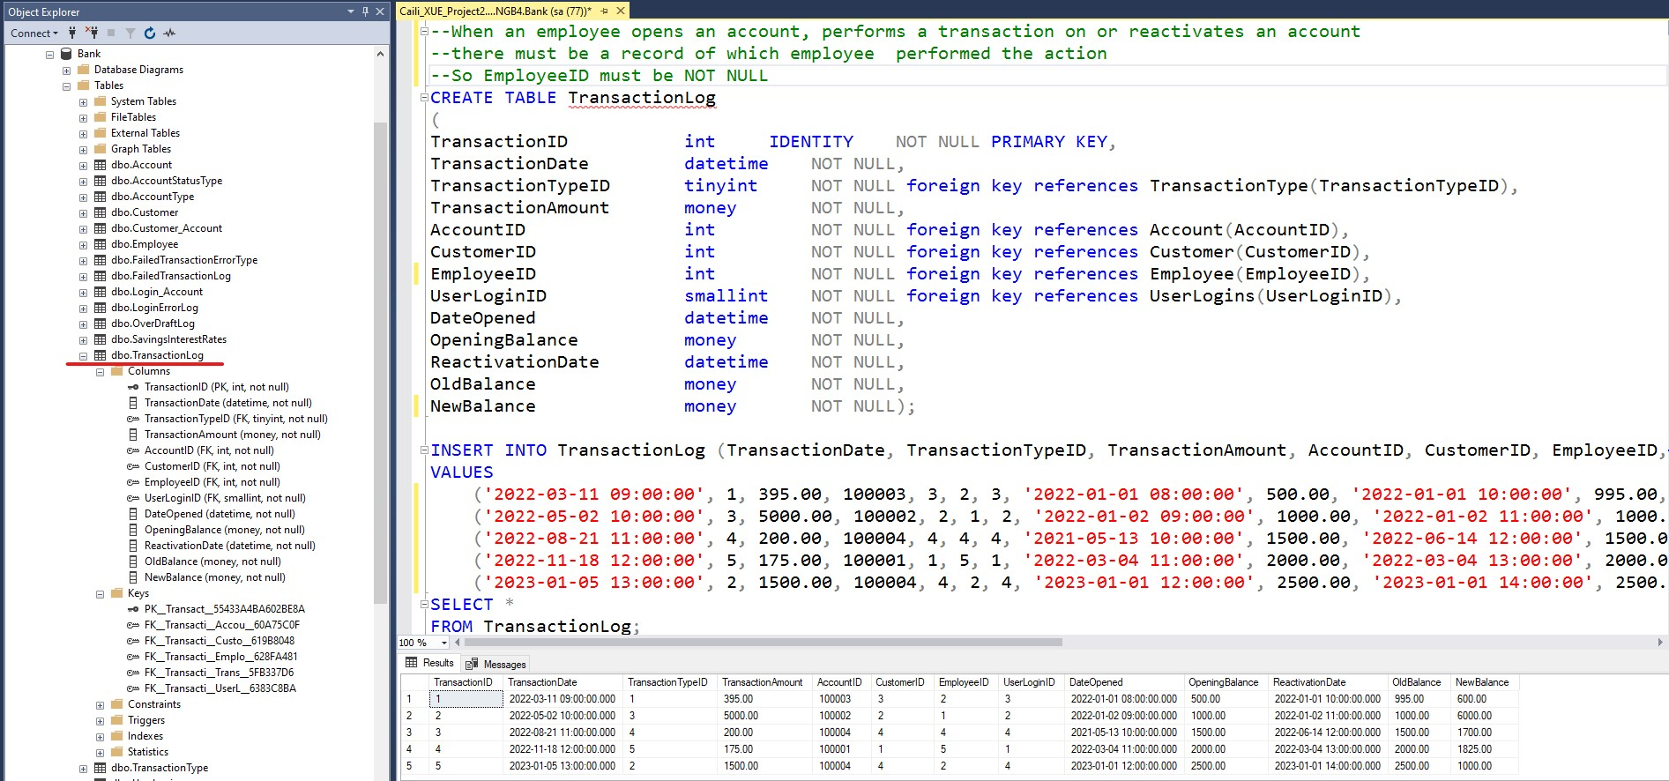
Table_TransactionLog
7

Slide 18
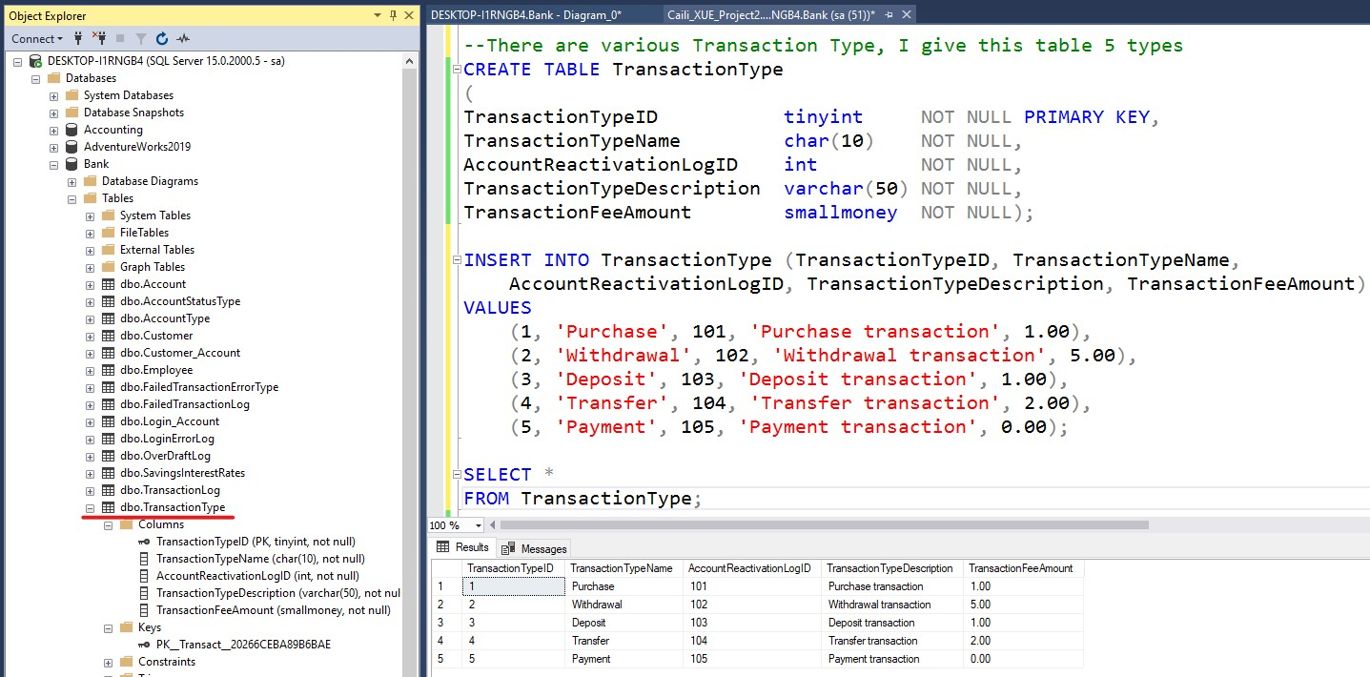
Table_TransactionType
7

Slide 19
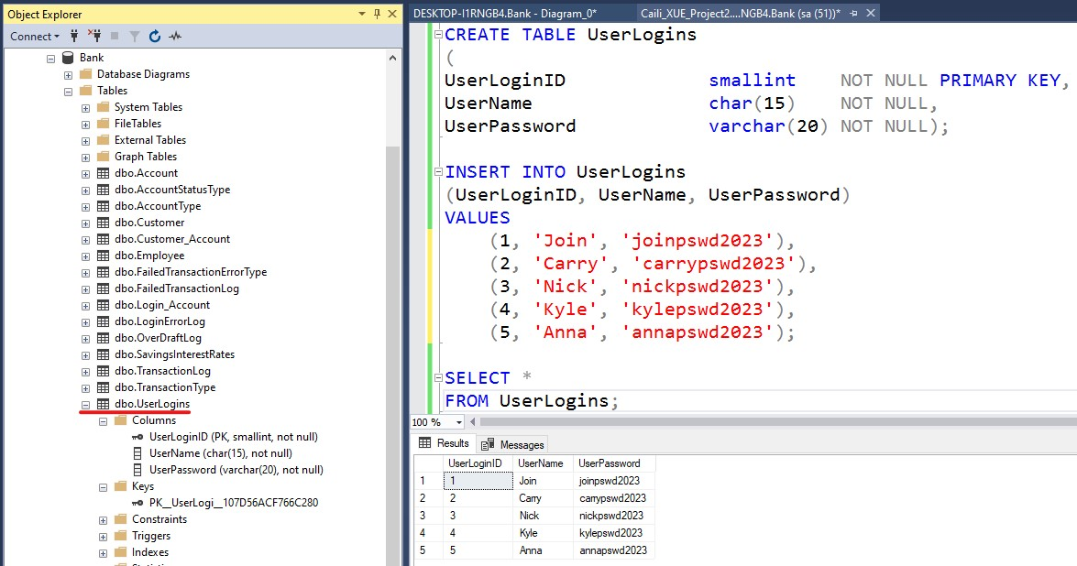
Table_UserLogins
7

Slide 20
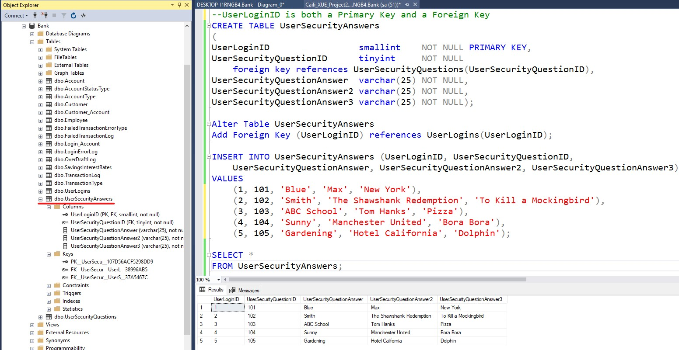
Table_UserSecurityAnswers
7

Slide 21
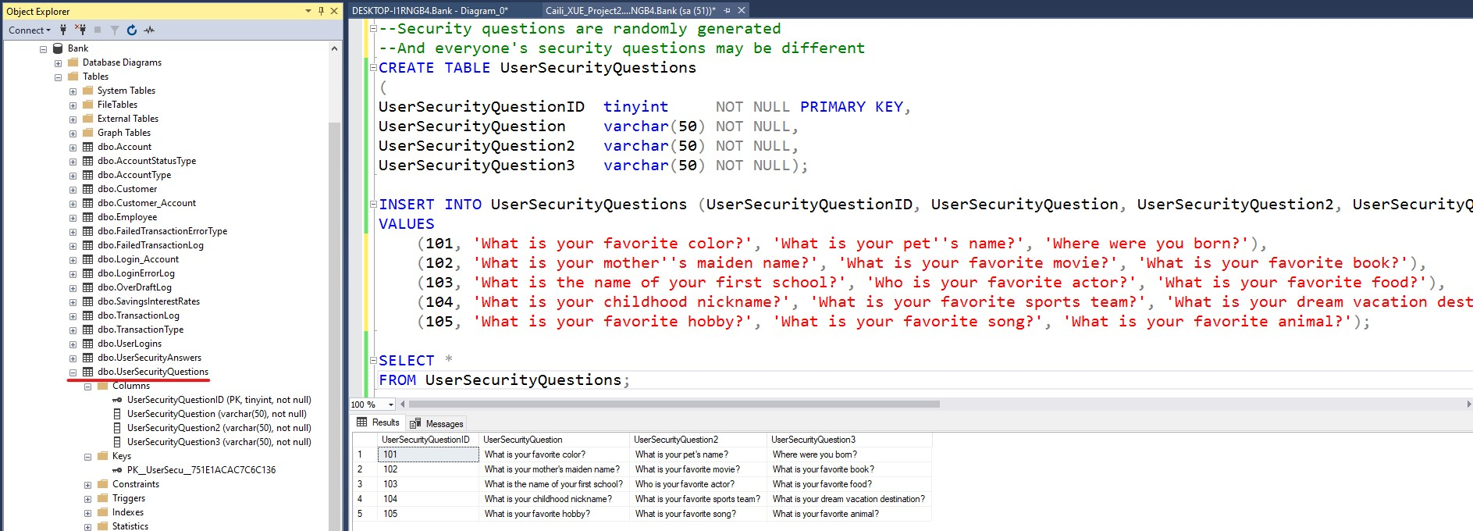
Table_UserSecurityQuestions
7

